Slide 1
KRITTER CANDIDATE ASSIGNMENT
Village Economic Growth Intelligence
Identifying high-growth micro-economies using satellite proxies (2020-2025)

Slide 2

Defining Economic Growth
Traditional data misses village-level expansion. We track three satellite proxies.
Infrastructure
Electrification
Human Capital
Dynamic World built-up probability.
VIIRS annual nightlight composites.
WorldPop demographic estimates.

Slide 3
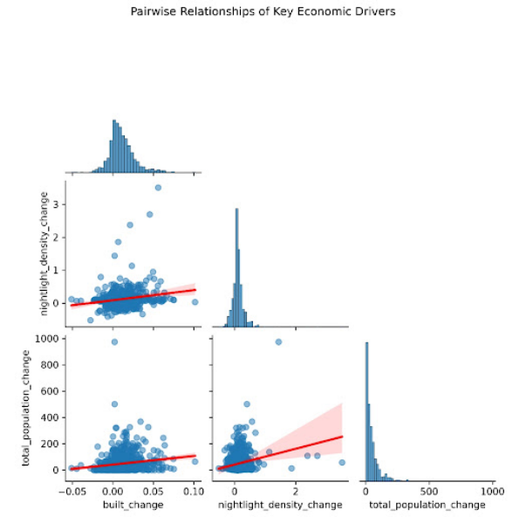
Signal Validation
Positive correlation: Construction drives illumination.
Negative vegetation correlation: Land-use transition confirmed.
Data insight: Proxies reflect identical ground trends.

Slide 4
Methodological Rigor
Spatial Filtering
Robust Scaling
Eliminated villages under 50 hectares.
Mitigated extreme right-tail outliers.
Prevents mixed-pixel light contamination from VIIRS sensor resolution limits.
Applied IQR-based scaling to prevent isolated spikes from dominating scores.

Slide 5
Normalized Weighted Index
Villages must show concurrent positive growth across proxies to qualify.
45%
45%
10%
Built-up Expansion
Nightlight Change
Population Shift

Slide 6
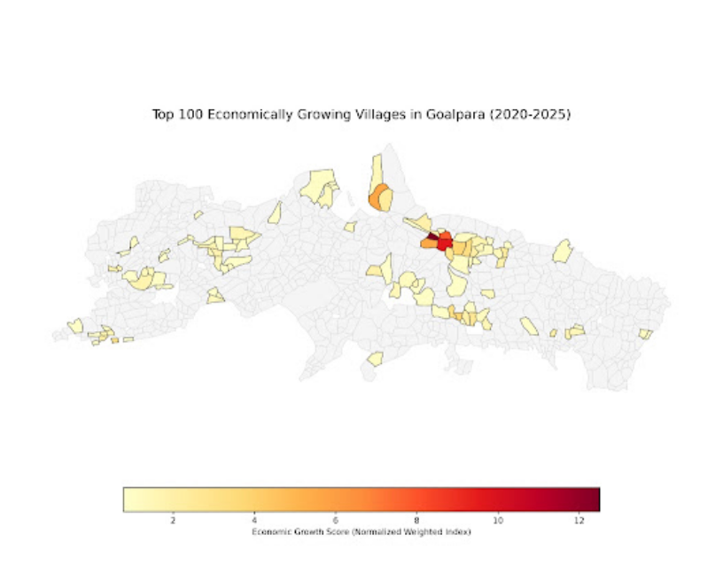
Top 100 Distribution
Spatial clustering reveals targeted zones of rapid infrastructure and capital investment.
Goalpara District Output

Slide 7
Next Steps & Limitations
CURRENT LIMITS
FUTURE SCALE
Restricted to state sample due to extraction latency.
Execute batch pipeline across all Indian districts.
Road network parsing pending historical OSM data.
Integrate dynamic weighting via PCA validation.

